Slide 1
All Glinski et al plots, stats, and test results
(these are screenshots and not publication quality)

Slide 2
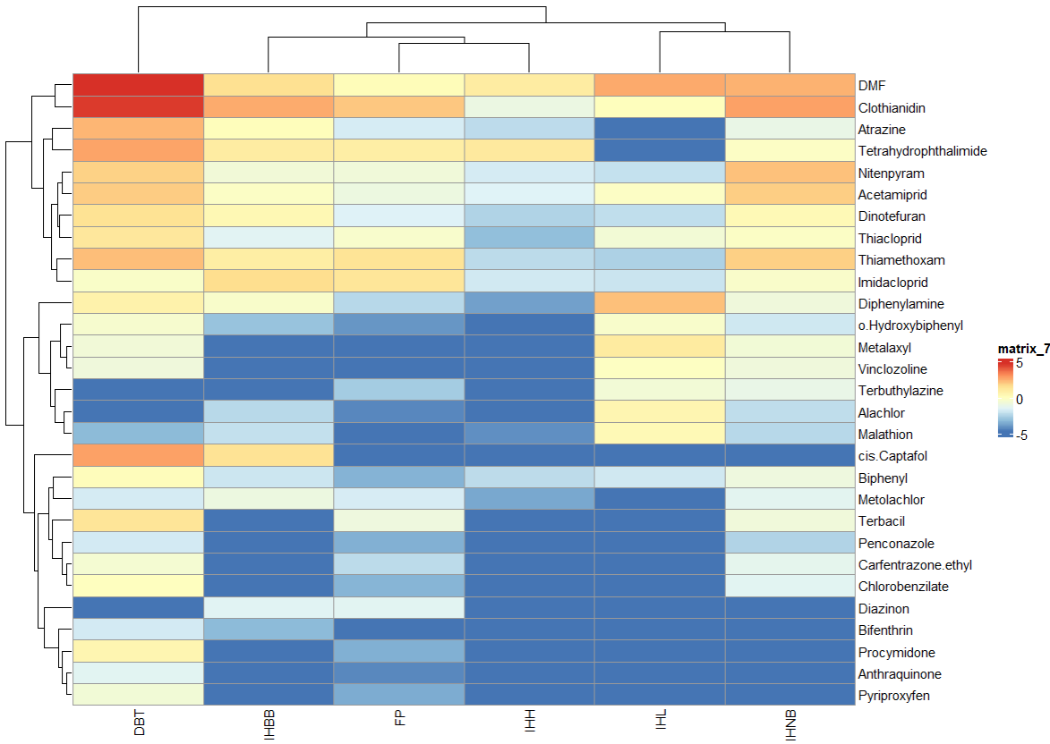
01a_cross_matrix_heatmap_concs.R—gbm_heatmap_all

Slide 3
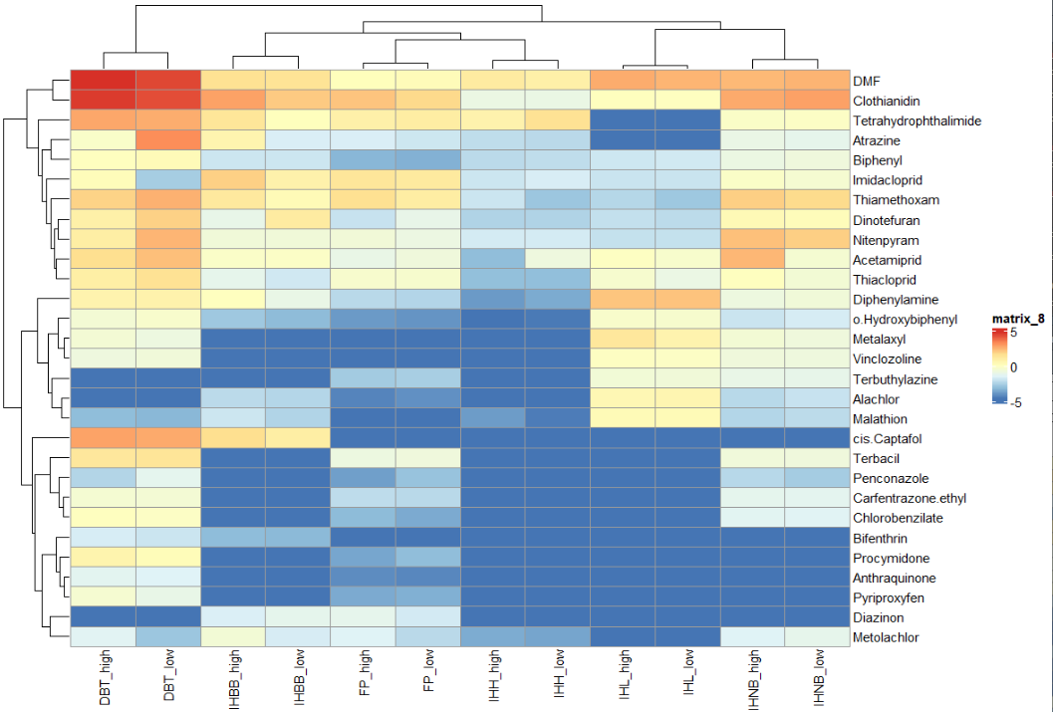
01a_cross_matrix_heatmap_concs.R—gbm_heatmap_all_ag

Slide 4
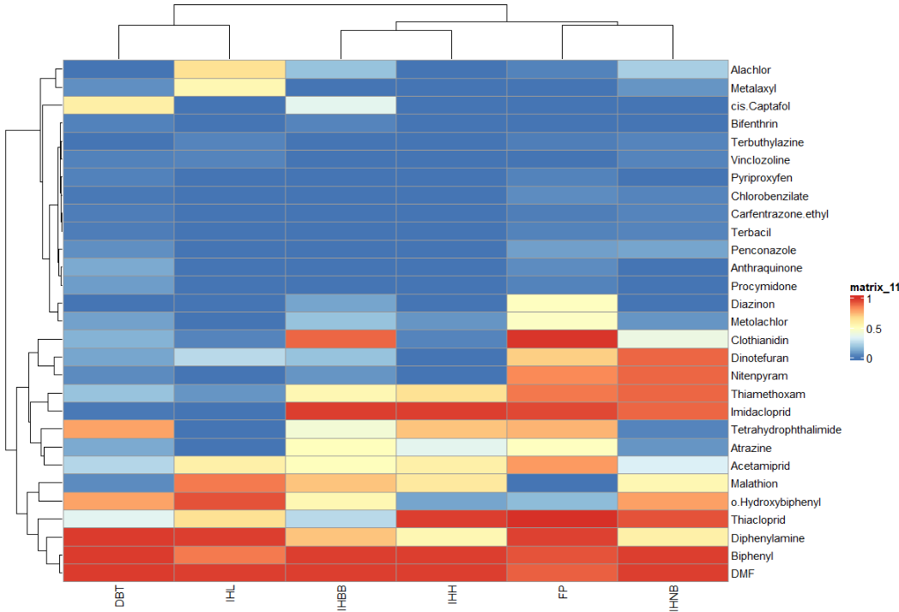
01b_cross_matrix_heatmap_detfreqs.R—gbm_heatmap_detfreq

Slide 5
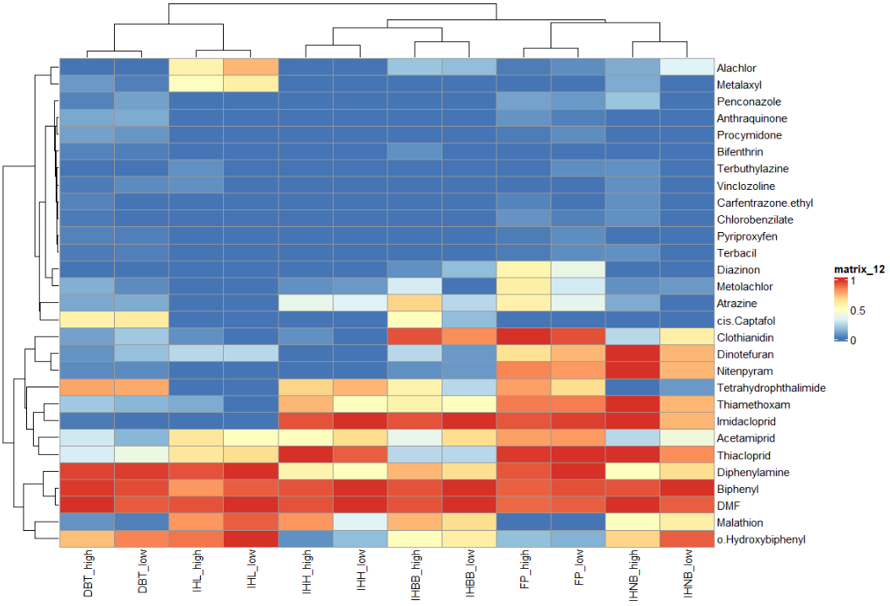
01b_cross_matrix_heatmap_detfreqs.R—gbm_heatmap_detfreqall_ag

Slide 6
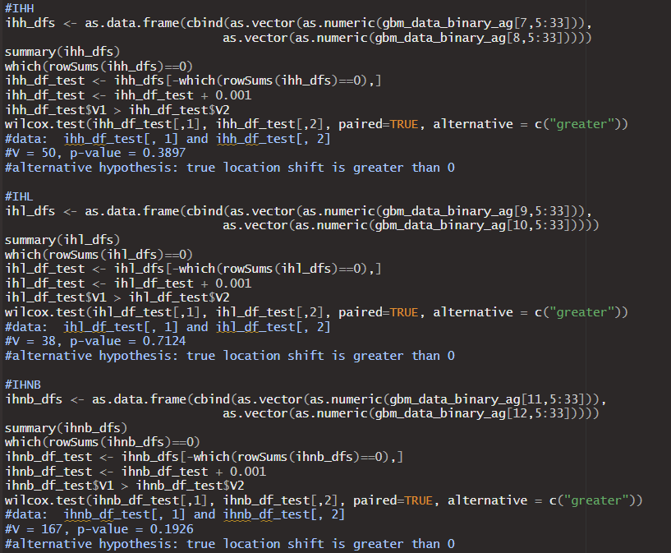
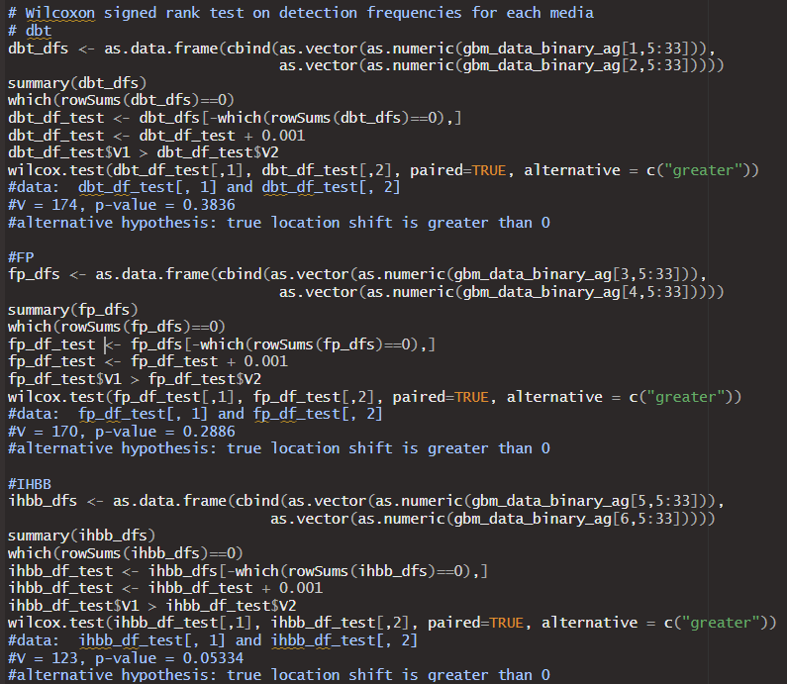
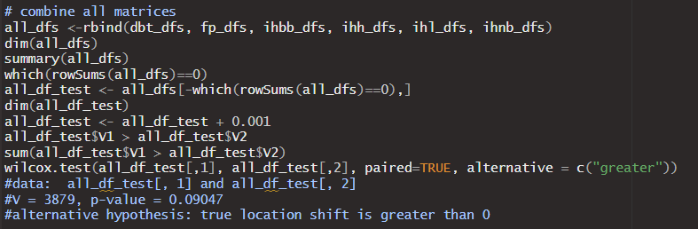
01c_cross_matrix_stat_tests_detection_freq.R

Slide 7
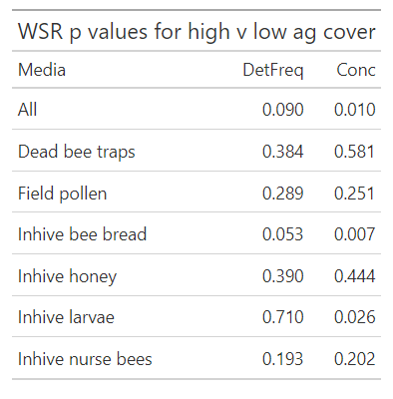
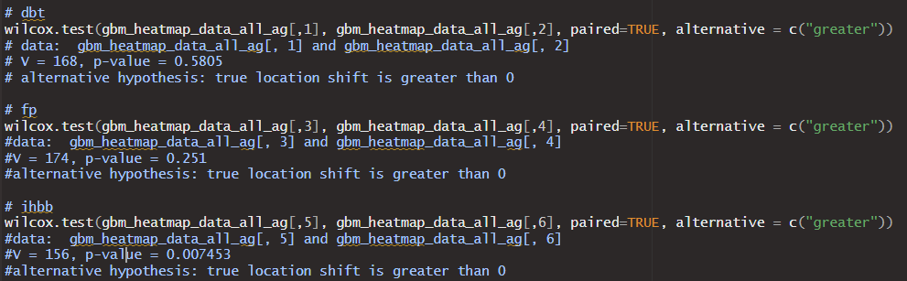
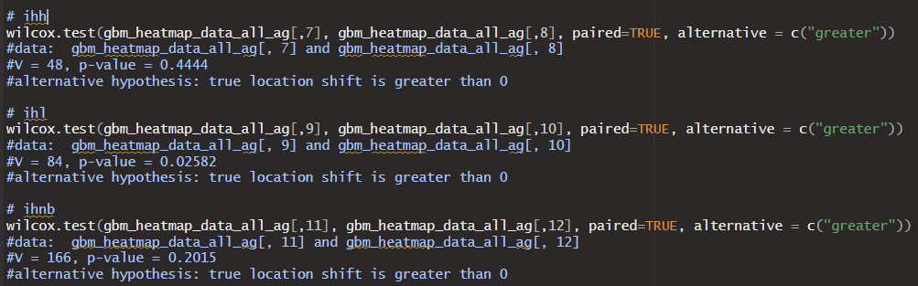
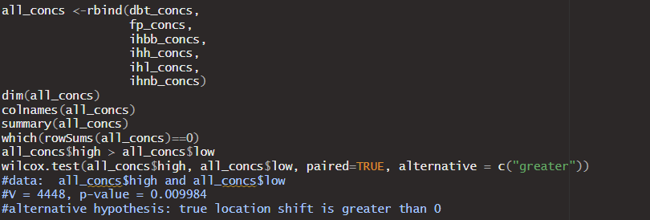
01d_cross_matrix_stat_tests_concentrations.R

Slide 8
01d_cross_matrix_stat_tests_concentrations.R

Slide 9
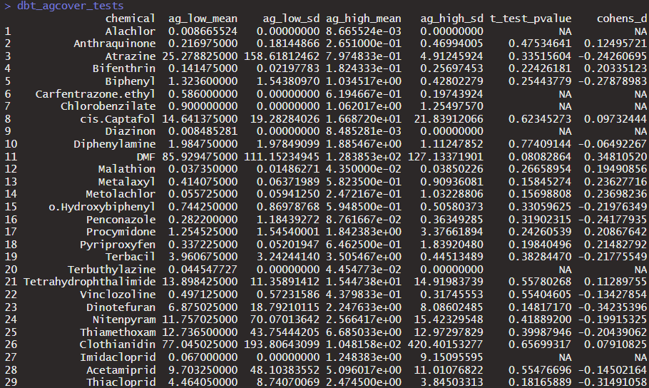
01e_ag_cover_concentration_comparisons.R—dead bee traps (t test and cohens_d values)

Slide 10
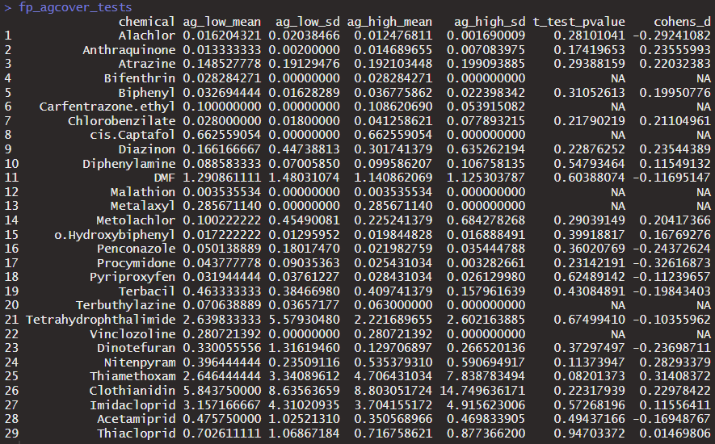
01e_ag_cover_concentration_comparisons.R—field pollen (t test and cohens_d values)

Slide 11
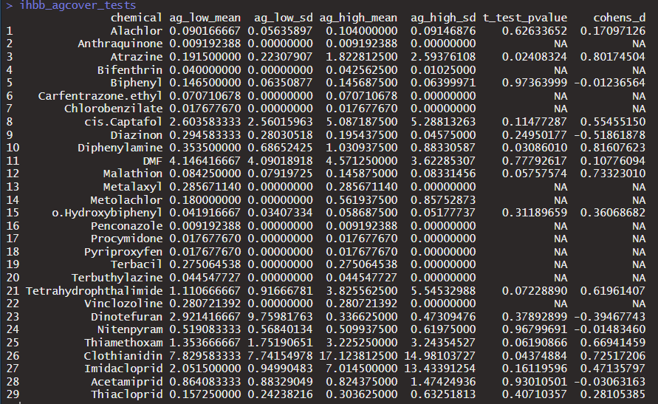
01e_ag_cover_concentration_comparisons.R—in hive bee bread (t test and cohens_d values)

Slide 12
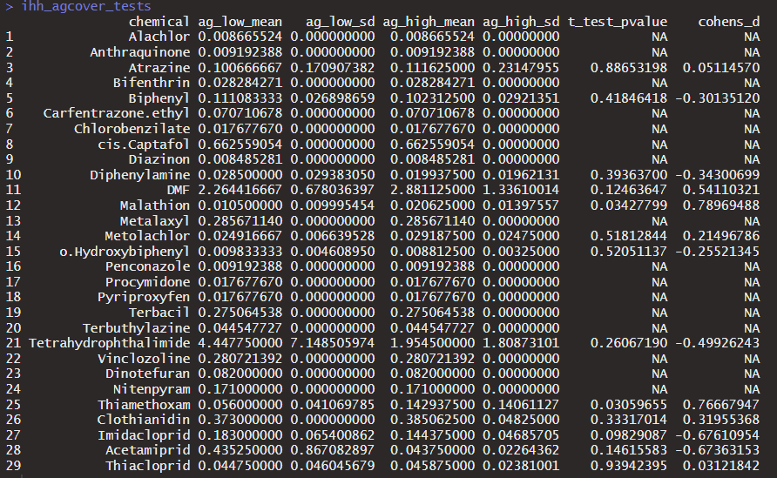
01e_ag_cover_concentration_comparisons.R—in hive honey (t test and cohens_d values)

Slide 13
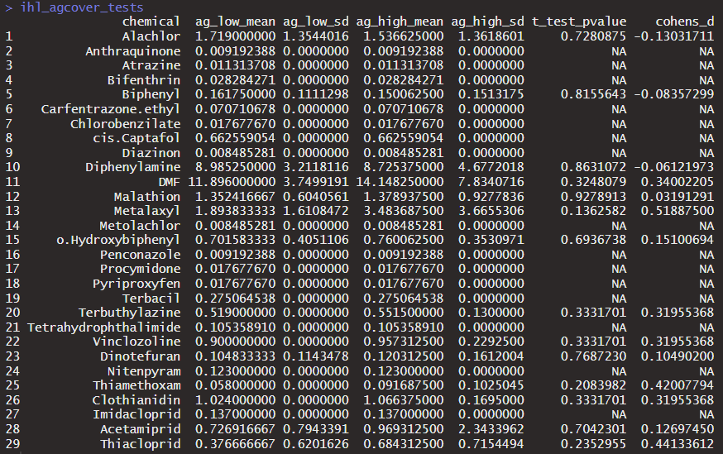
01e_ag_cover_concentration_comparisons.R—in hive larvae (t test and cohens_d values)

Slide 14
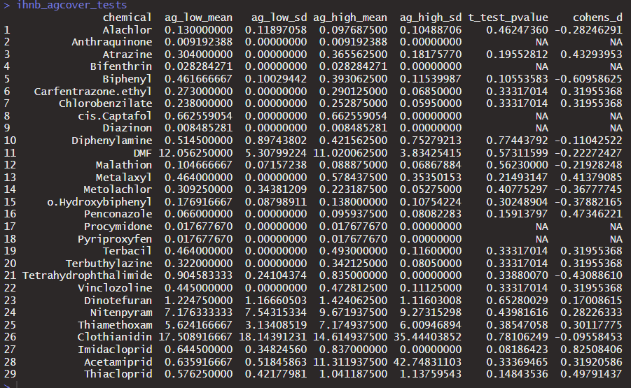
01e_ag_cover_concentration_comparisons.R—in hive nurse bees (t test and cohens_d values)

Slide 15
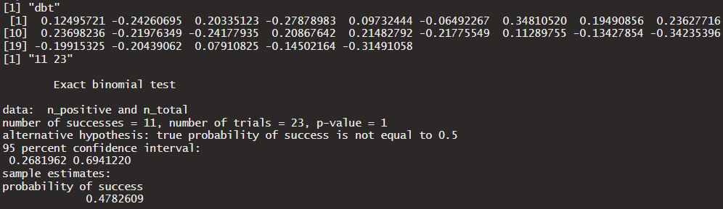
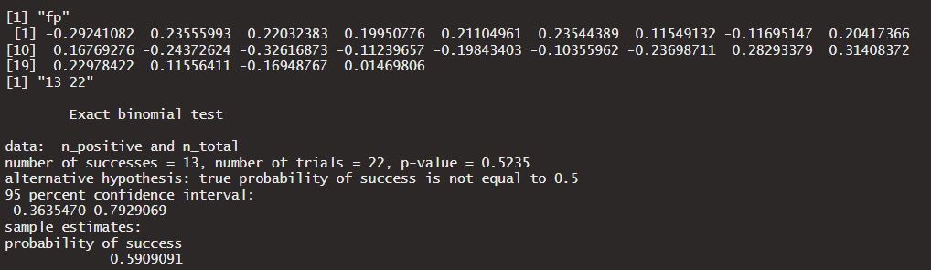
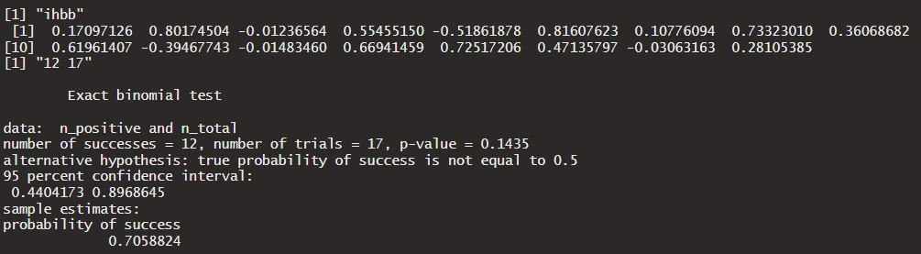
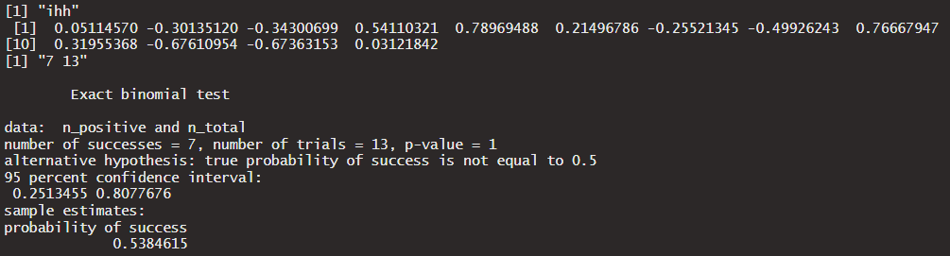
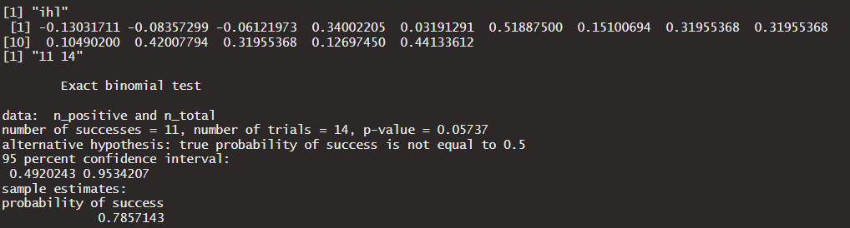
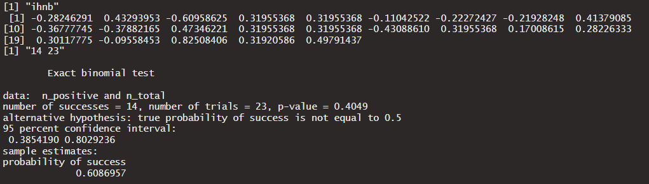
01e_ag_cover_concentration_comparisons.R—Exact binomial tests on Cohen’s D values of ag cover across all chemicals by media (these tests look at whether there is statistically significant # of higher chemical concentrations in the contrast versus lower concentrations)

Slide 16
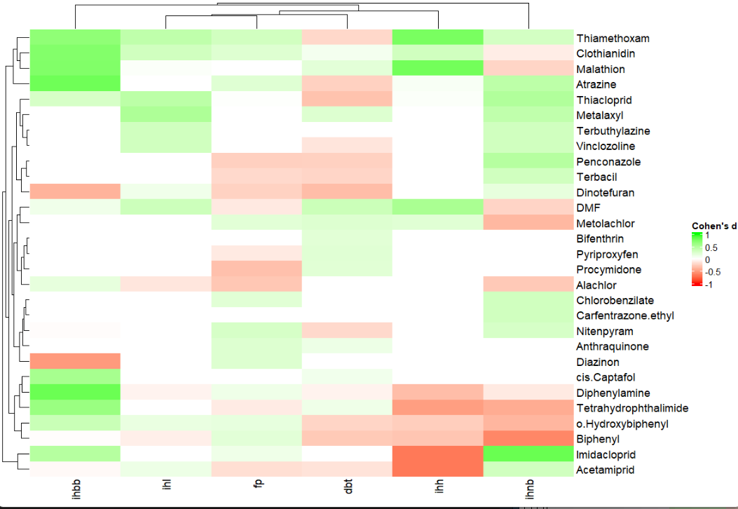
01e_ag_cover_concentration_comparisons.R—in hive nurse bees

Slide 17
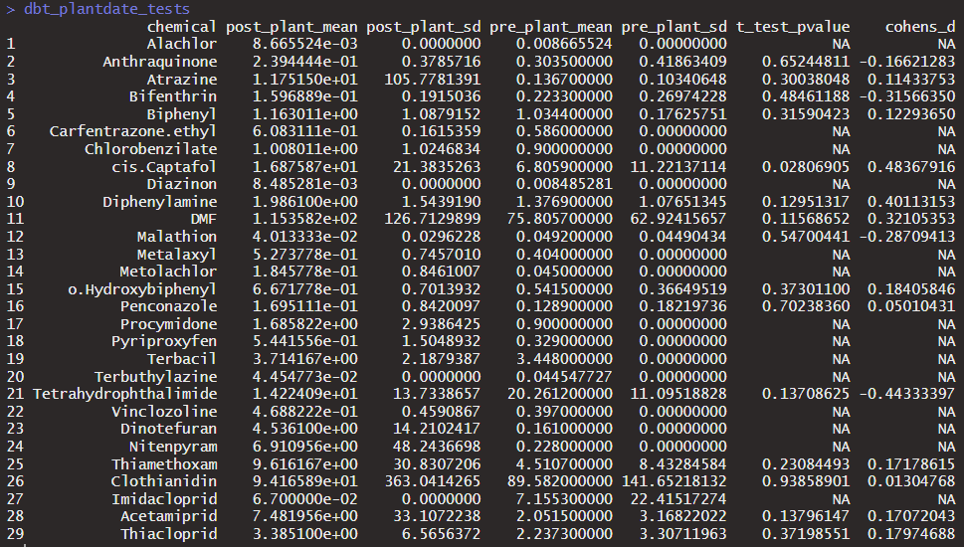
01f_planting_time_concentration_comparisons.R—dbt_plantdate_tests

Slide 18
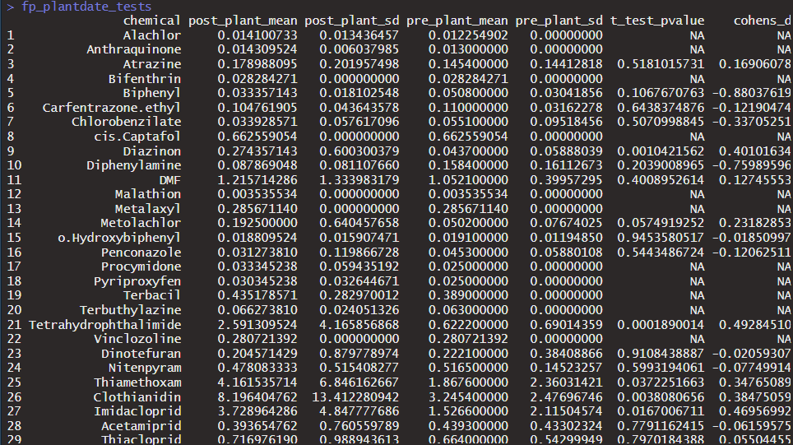
01f_planting_time_concentration_comparisons.R—fp_plantdate_tests

Slide 19
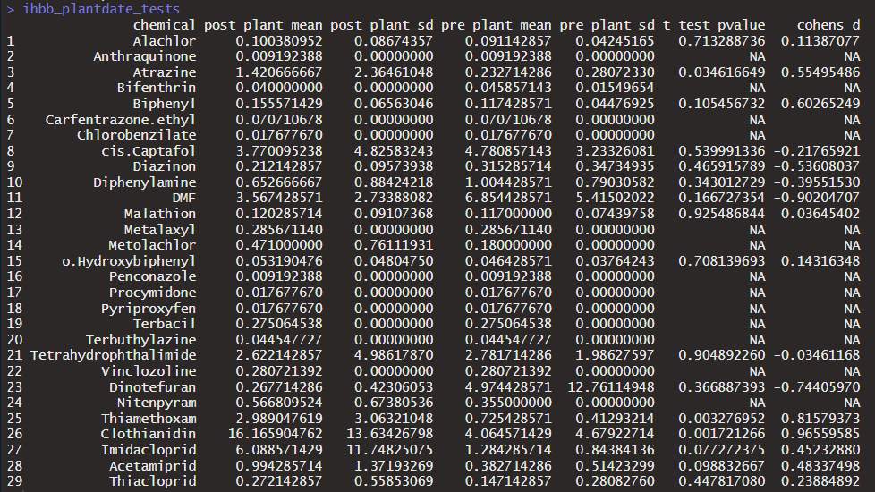
01f_planting_time_concentration_comparisons.R—ihbb_plantdate_tests

Slide 20
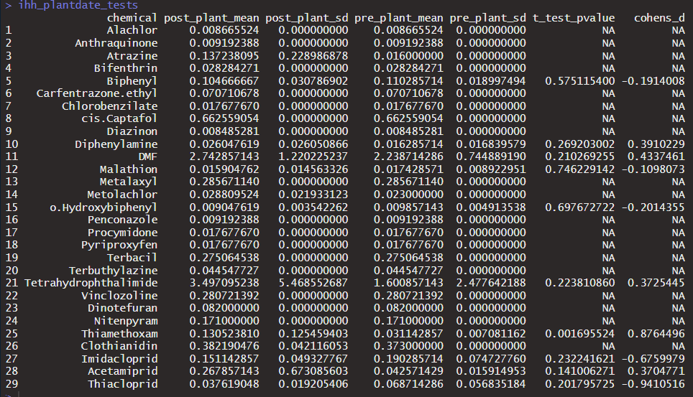
01f_planting_time_concentration_comparisons.R—ihh_plantdate_tests

Slide 21
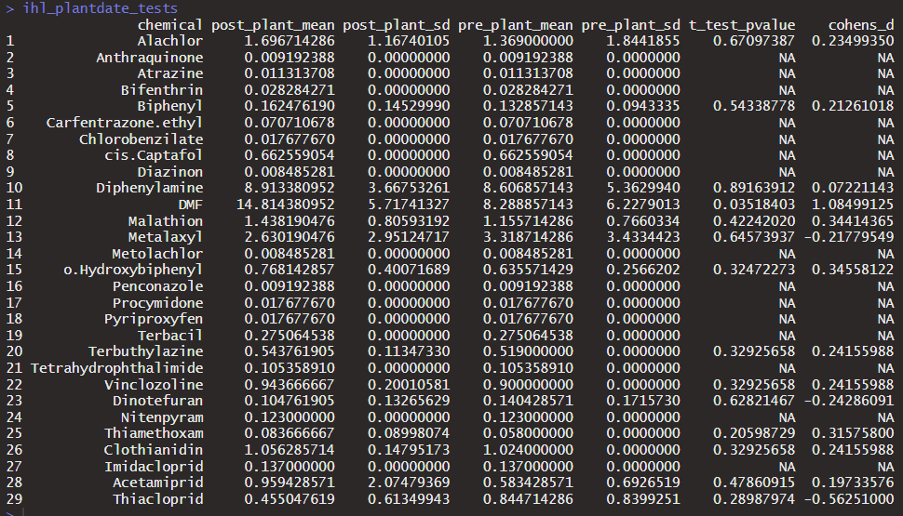
01f_planting_time_concentration_comparisons.R—ihl_plantdate_tests

Slide 22
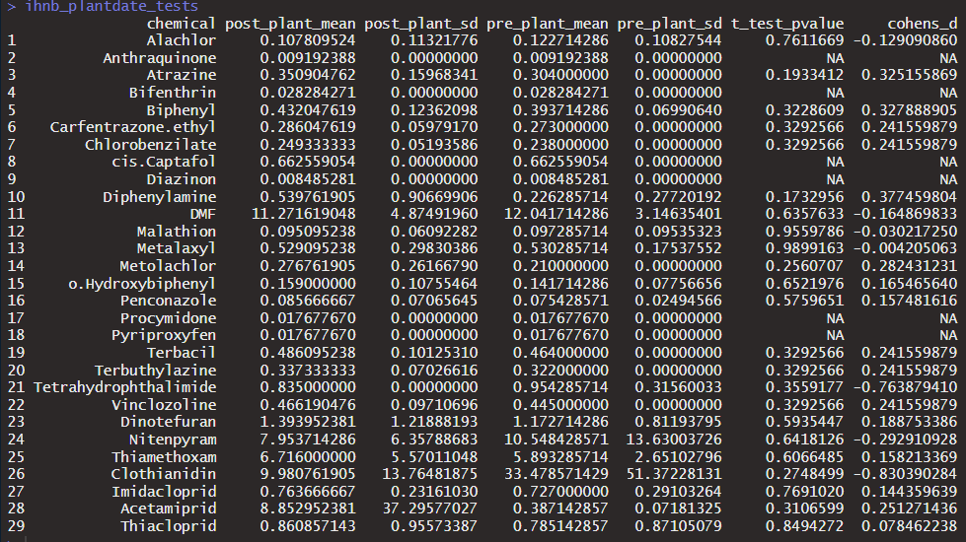
01f_planting_time_concentration_comparisons.R—ihnb_plantdate_tests

Slide 23
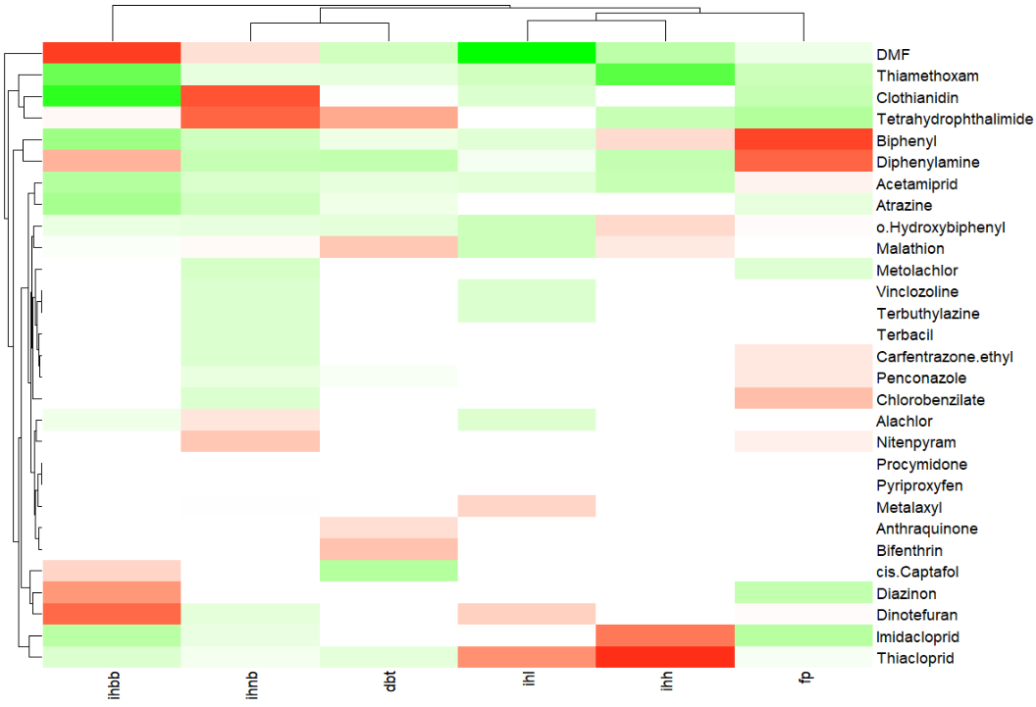
01f_planting_time_concentration_comparisons.R—date_compare_heatmap

Slide 24
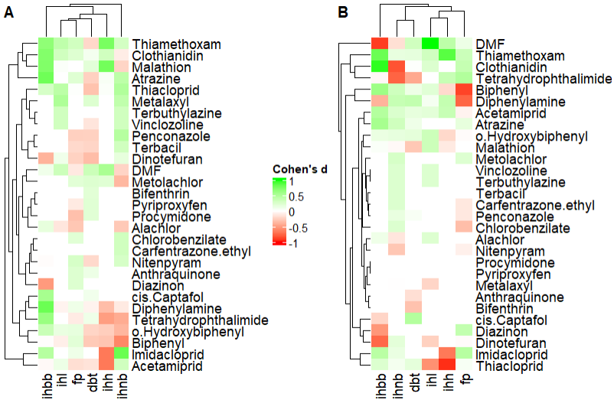
01g_combined_effect_sizes_figure.R—effect_sizes_combined

Slide 25
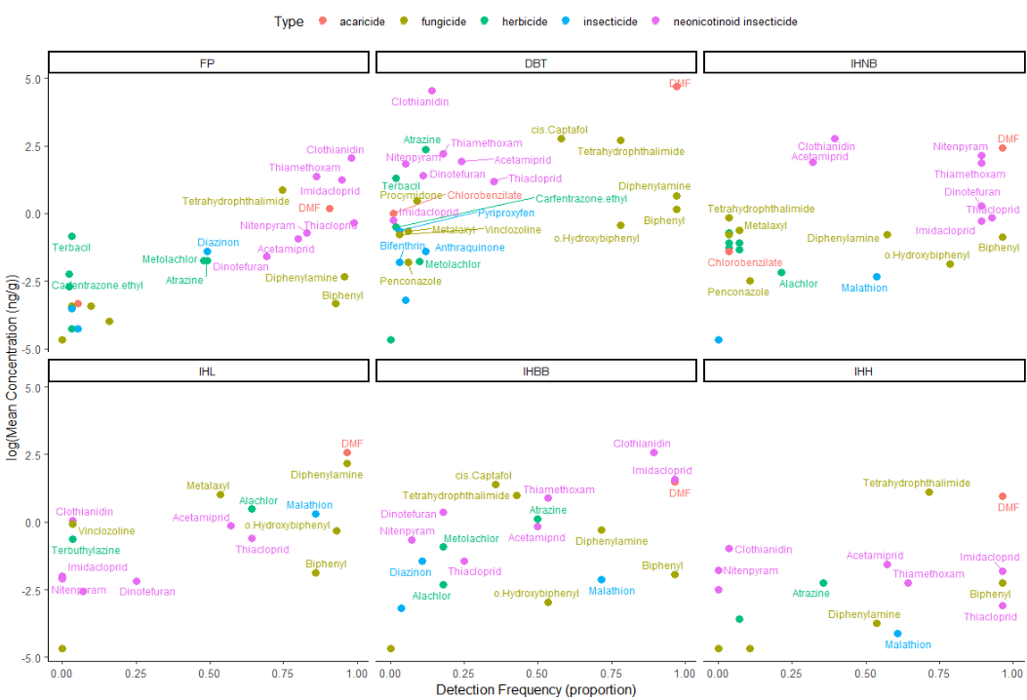
02a_summary_stat_figures.R—gbm_summary_plot_matrices

Slide 26
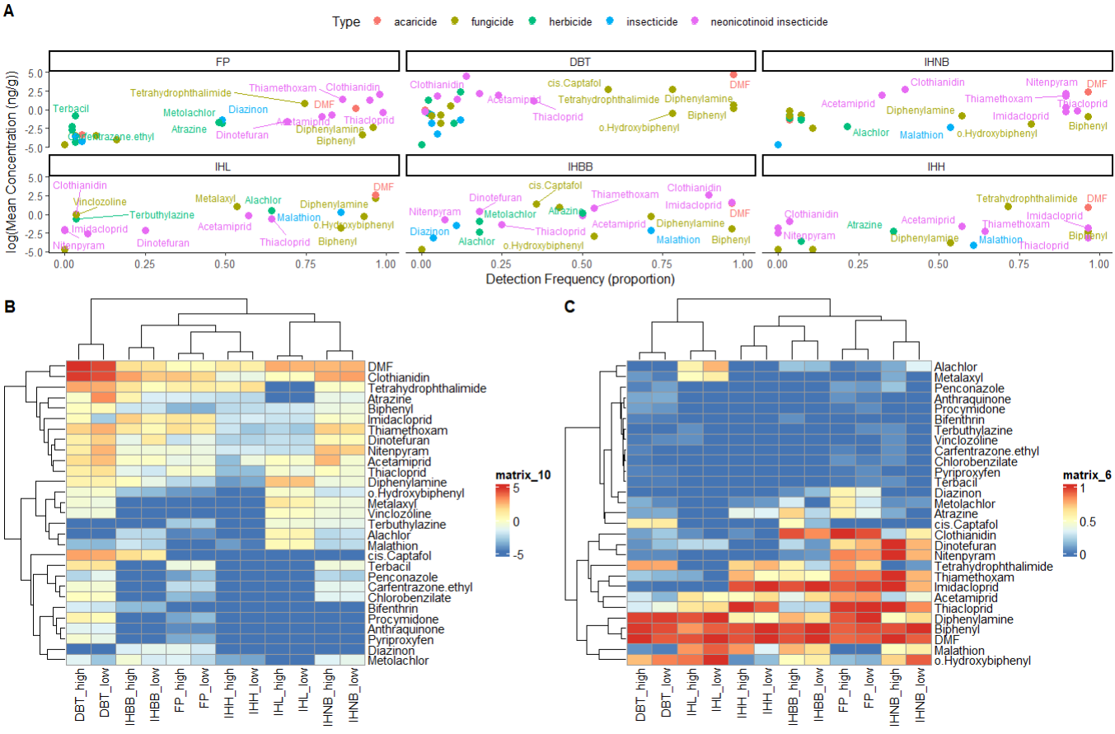
02b_combined_manuscript_figure.R—concs_dets_combined

Slide 27
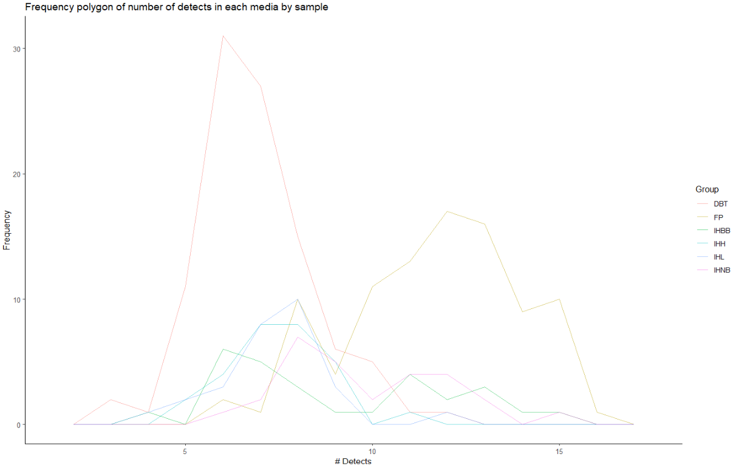
03a_ndetects_boxplots.R—

Slide 28
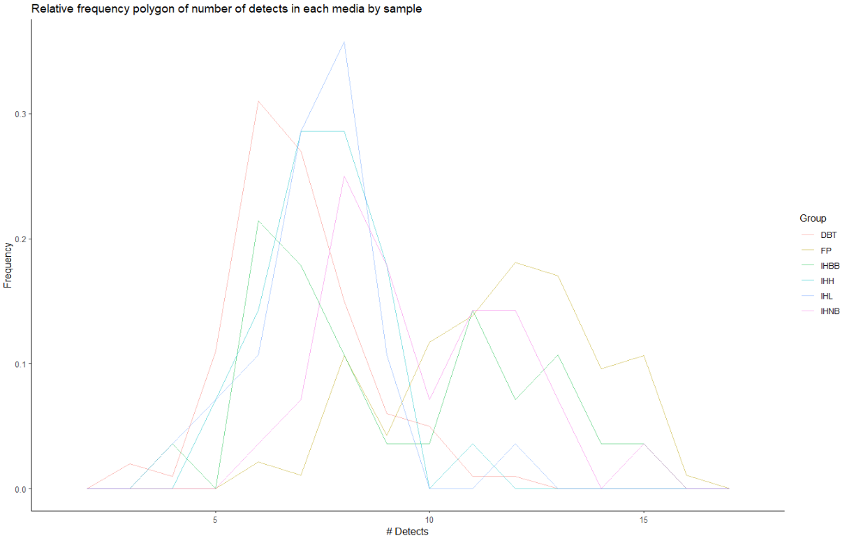
03a_ndetects_boxplots.R—

Slide 29
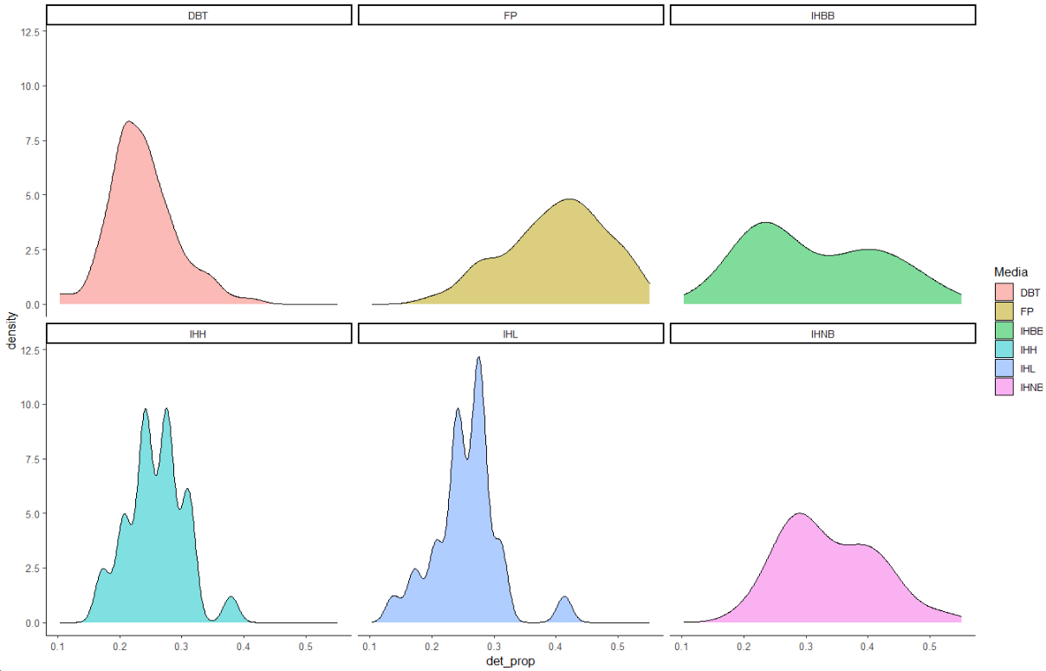
03a_ndetects_boxplots.R— (distribution of the # detects in the samples for each media type)

Slide 30
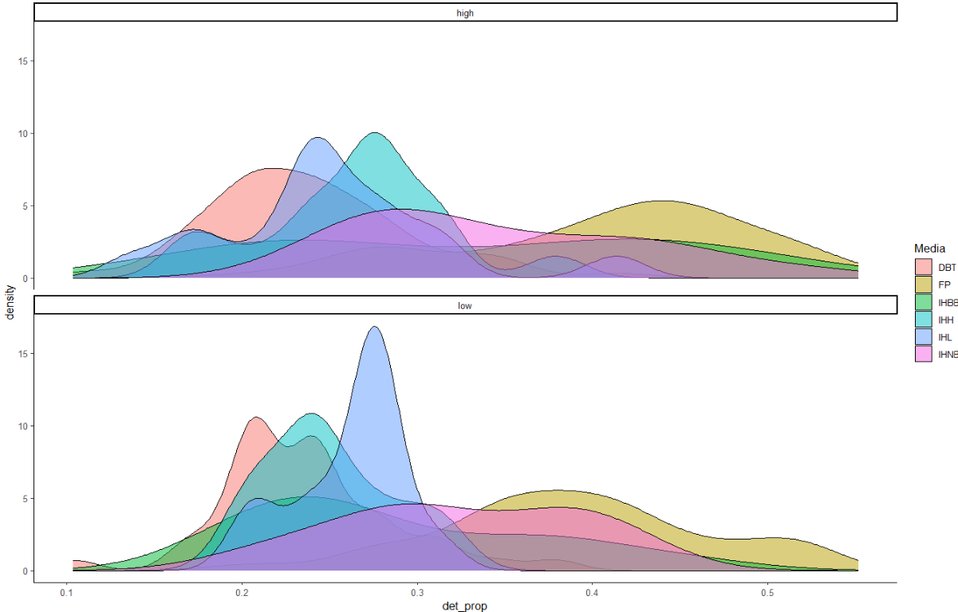
03a_ndetects_boxplots.R—— (distribution of the # detects in the samples for each media type)

Slide 31
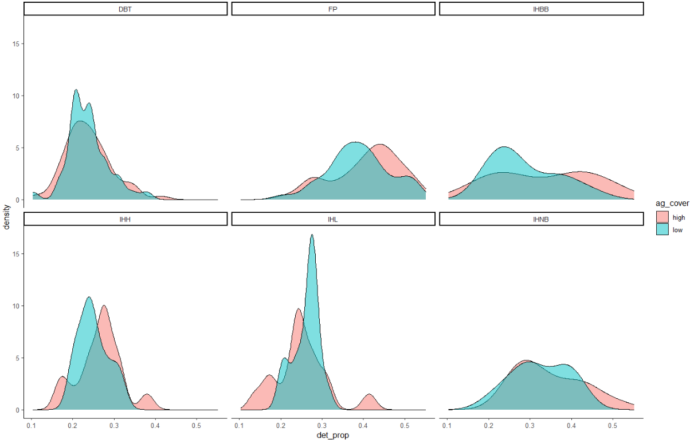
03a_ndetects_boxplots.R—

Slide 32
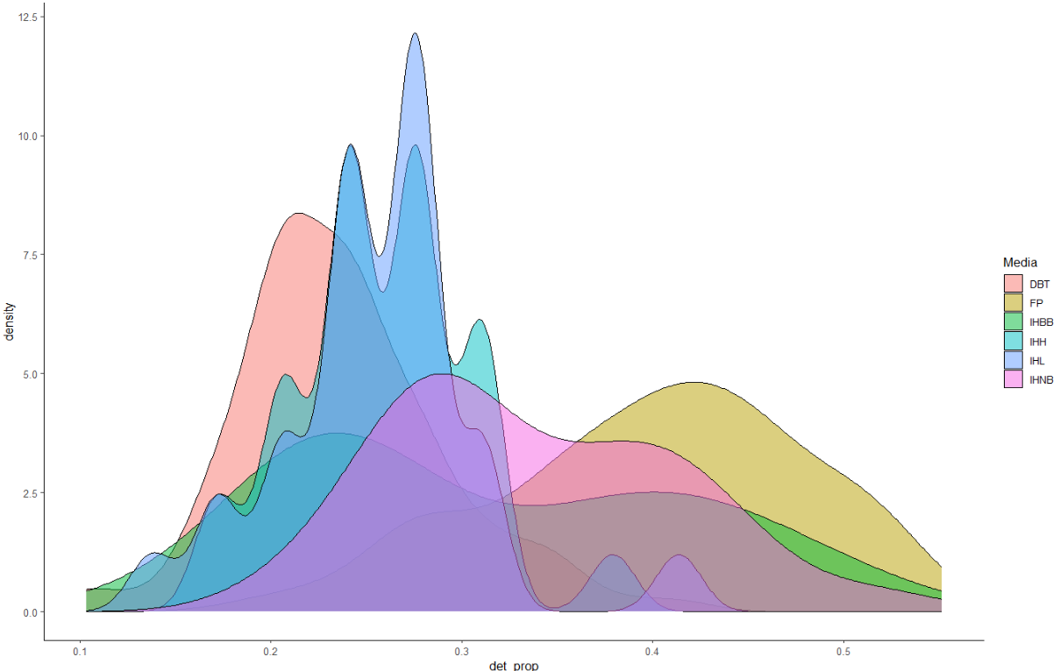
03a_ndetects_boxplots.R—

Slide 33
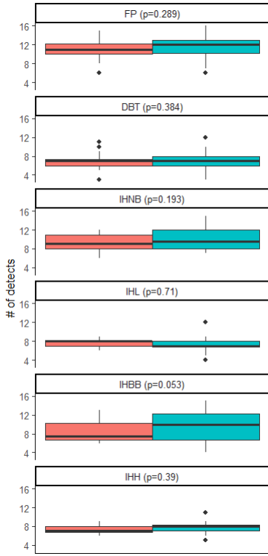
03a_ndetects_boxplots.R—

Slide 34
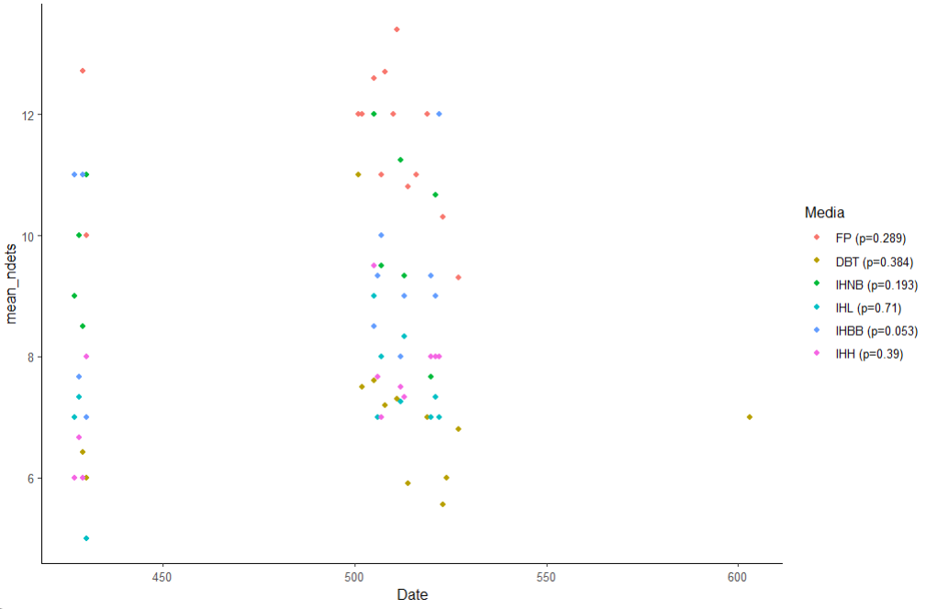
03a_ndetects_boxplots.R—

Slide 35
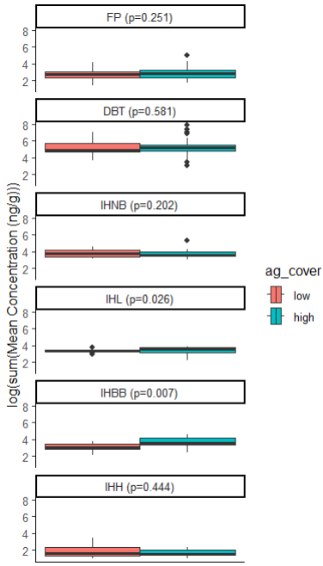
03b_cumulative_concs_boxplots.R—

Slide 36
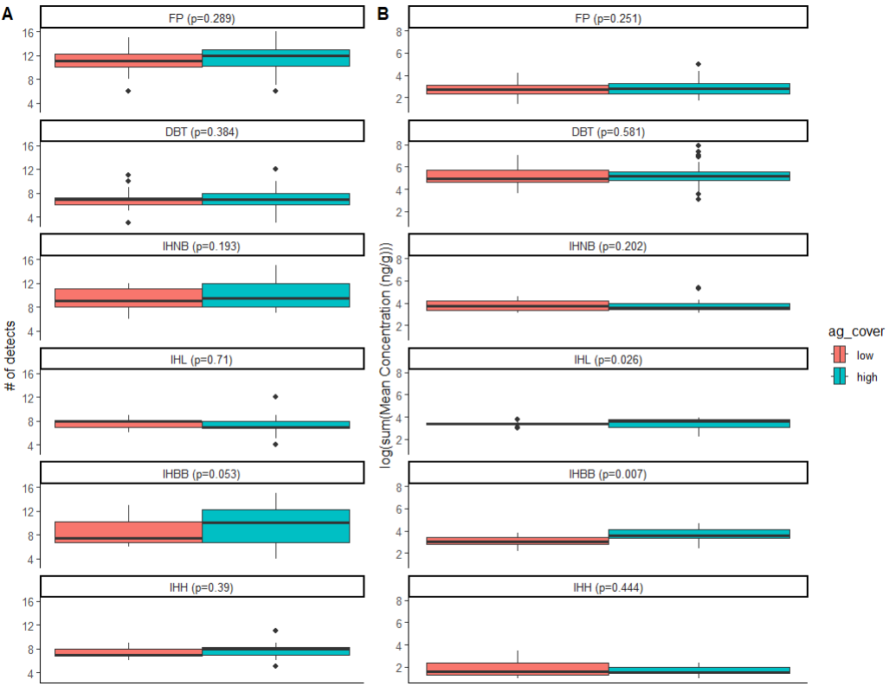
03c_combined_agcover_boxplots.R—

Slide 37
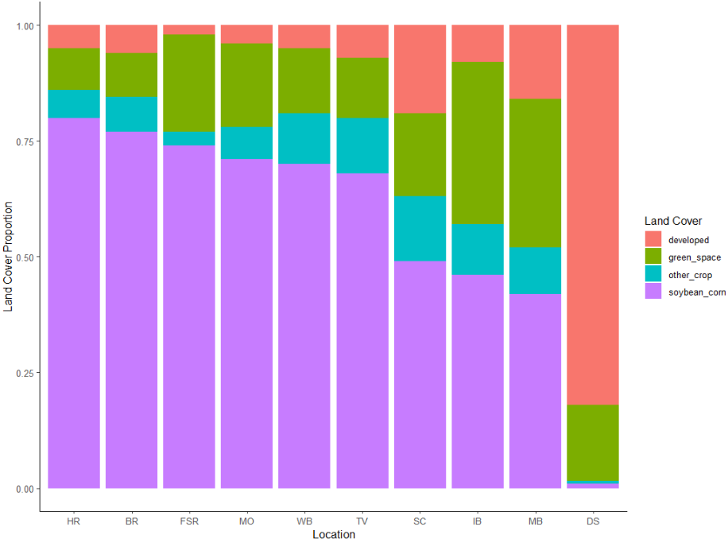
04_stacked_boxplots_land_cover.R—

Slide 38
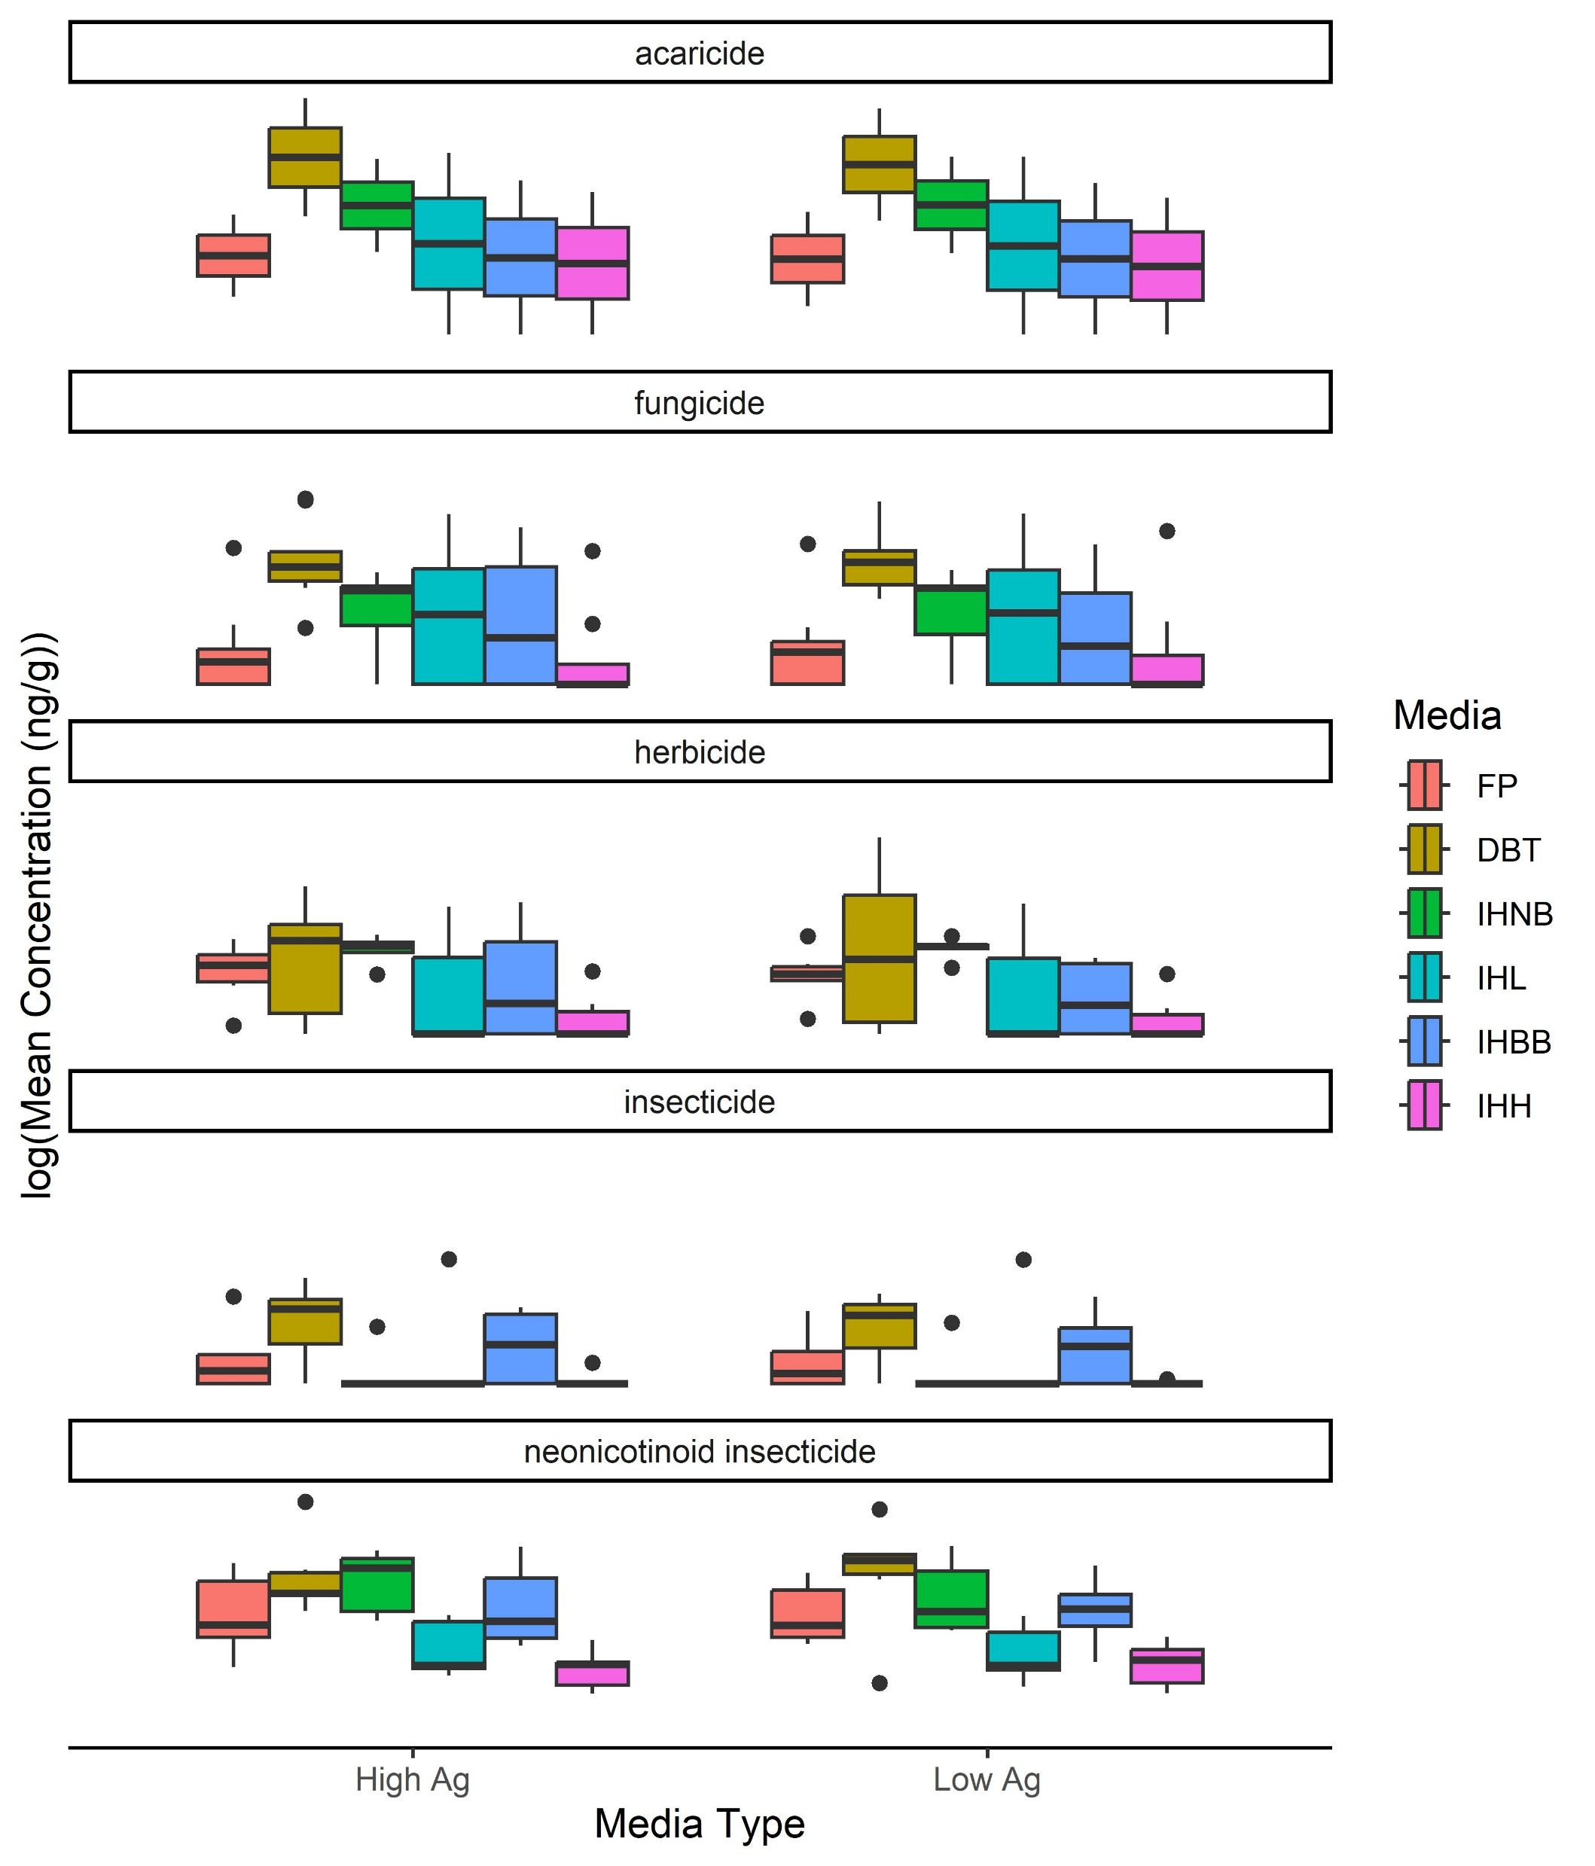
05a_chemical_boxplots_agcover.R—boxplots_chem_classes_agcover

Slide 39
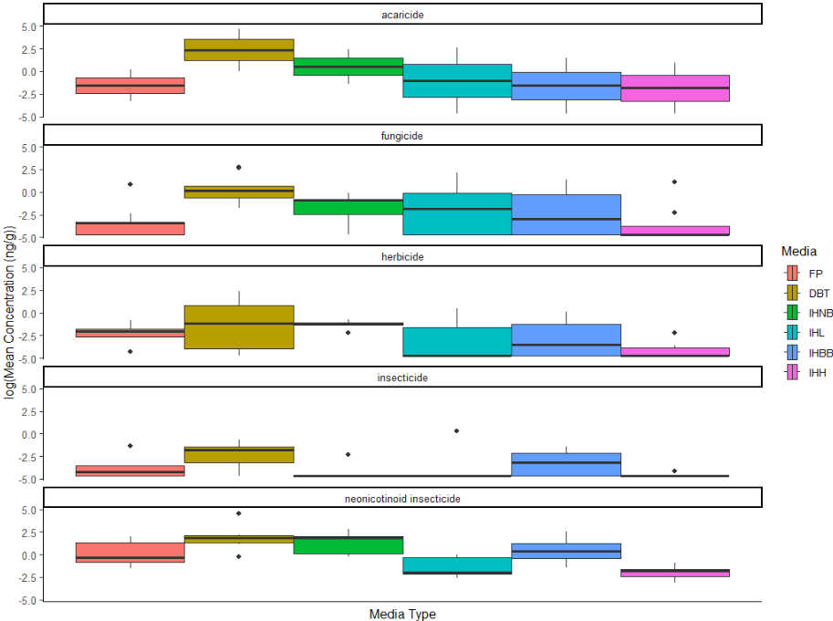
05b_chemical_class_boxplots.R—boxplots_chem_classes

